Slide 1
CASTPONE PROJECT – 2 INTRODUCTION

Slide 2
NATURAL LANGUAGE PROCESSING [SENTIMENT ANALYSIS AND CLASSIFICATION RESULT] [restaurant reviews]

Slide 3
OBJECTIVE:
Learn about natural language processing and its uses for deep learning projects.
Build a strong background and get detailed information regarding sentiment analysis and its role in development of different industries.
Try to find detailed relation of machine learning algorithms with unorganized data and built classification model.
From classification get the information related to model which best classify the data and give the result very well on it.
Work for future development of industry using the obtained result of sentiment analysis and try to improve the focus areas.

Slide 4
Why I choose this project?
In every industries for future development, organization and authorities focuses on their customer behaviours and their opinions towards them.
So they analyse their past mistakes which get highlighted by their customers on their products or service to improve their current services for better experience of customer.
For this they use deep learning concepts in short natural language processing for sentiment analysis from which they can get more information regarding the areas which need to repair according to customers.
On that basis they try improvise their performance for customer satisfaction and for their business building in future.
Also they try to change their style according to customer needs so they can fully focus on their weak points also go step by step with time and give priorities for automation.

Slide 5
WHY I CHOOSE THIS PROJECT?
Also we all know NLP used in different areas like email filtering, chatbots , machine translation , smart assistants etc so to understand it and more information about how it can deal with this application I choose this project.
As the base of deep learning area is machine learning so to cleanly see how can deep learning concept use ML algorithms as their base to carry out target task I choose to go with NLP.
NLP is quiet easy than any other deep learning concepts to understand also its working in hotel management industry is really remarkable.
Now-a-days restaurant and other food related industries develop with new era so they using ML technologies in favour of their business.
So to understand how can restaurant management use ML and deep learning in their development I decide to pick up this project.

Slide 6
GOAL SETTING OF THE PROJECT?
Understand the given data which getting use for sentiment analysis and build a proper classification model to give clean results.
Get familiar with unstructured data and its handling and manipulate it for target achievement.
Go for closer look on customer behaviour and analyse it for organization improvement.
Understand the work of NLP in sentiment analysis and its applications in different industries.
Go in deep with concept of use of ML algorithms in NLP for classification purpose and its working with unstructured data.
Deal with negative areas which are highlighted by customers with detailed information from NLP processing and work on it for future development.

Slide 7
PLANNING ON PROJECT:
As dataset is unstructured so first step is that try to get closer-look on data and find with primary detection that it has any missing part or not.
Then go for detailing look of reviews and find out their proper structure means are they only in english language or any other language.
Then properly handle it using data cleaning and pre-processing for further analysis.
Go for EDA analysis and find detailed structure of the data.
Then ready the data for classification model building and analyse it through different ML algorithms.
Interpret the sentiment of customer in detail and draw its proper structure using different tools of python.
Find out the best fitted classifier model for data and plot the final conclusion.

Slide 8
PROCEDURE FOR TARGET ACHIVEING:
Data understanding
Importing different libraries for different operations.
Data cleaning
EDA analysis
Data pre-processing
Model building
Find out the best fitted model using NLP and different ML algorithms and draw the conclusion.

Slide 9
MAIN PART PROJECT EXECUTION [BODY]

Slide 10
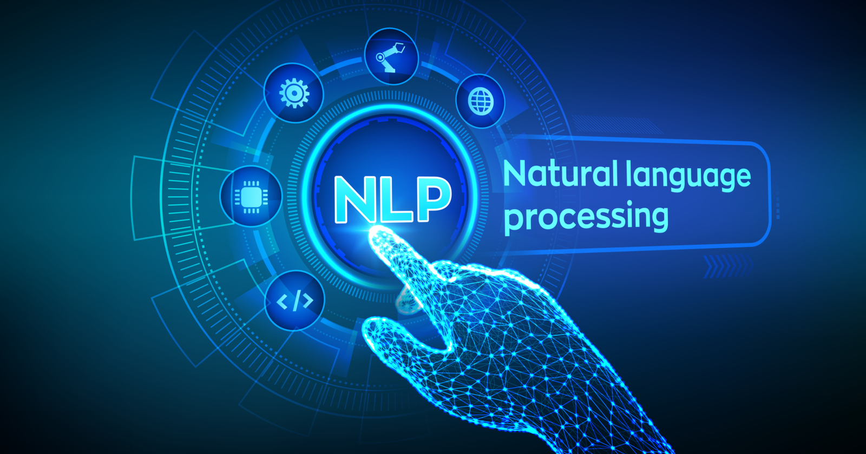
PROBLEM STATEMENT:
To provide a sentiment analysis system for customer review classification, that may be helpful to analyse the information where opinions are highly unstructured and are either positive or negative.
Do the sentiment analysis of restaurant reviews and interpret the customer behaviour towards different restaurants and find the best fitted model for classification of the reviews for future development of restaurant management industry.

Slide 11
ABOUT DATASET:
The dataset I get for target achieving is complete unstructured with customer reviews and its rating details.
The dataset is completely suited for NLP process and its operations.
The dataset contains 10000 rows with 8 columns.
It contains reviews of different restaurants done by customer as per their service and other related stuff regarding food.
It also contains name of the customer , its rating given to the restaurants and at what time the rating is posted.
The data is completely natural language base with not any continuous value in it.
It is structured for sentiment analysis by which it can focuses on customer behaviour towards restaurant management system.

Slide 12
DATASET ATTRIBUTES:
Restaurant : Name of the restaurant.
Reviewer : Name of the customer which give review to the restaurant.
Review : Review of the customer.
Rating : Points given by the customer to restaurants in the scale of 1 to 5 to describe its compatibility in all manners.
Metadata : Data related to reviews and its followers.
Time : Time related to the posting of review by the customer.
Pictures : Data related to customer pictures.
7514 : A numerical column with only one value.

Slide 13
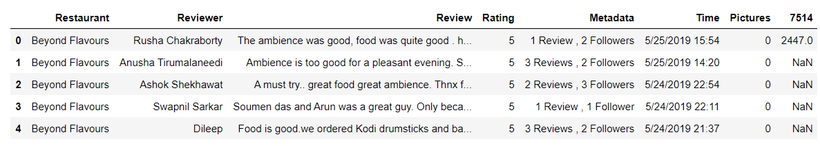
LOADING THE DATASET AND IMPORTING LIBRARIES:
Firstly I loaded the dataset in python and saw its detailed structure means how it looks like.
Then I import the needed libraries which are getting further useful for model building and target achieving.
DATASET LOADING

Slide 14
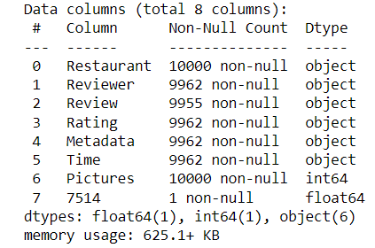
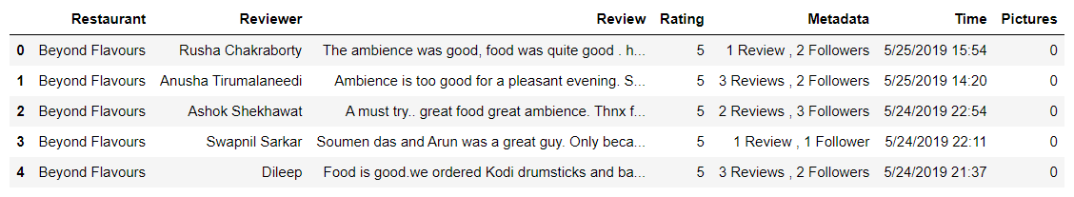
DATA CLEANING:
For data cleaning I obtain the primary info about each column means column type, column contain and data size.
As firstly mentioned the data has 10000 rows with 8 columns. Their type are mentioned in the picture.
Then I drop the column ‘7514’ as it has only one value and its of no use in further data processing.
A)Column type information
B)Appearance of data after dropping the column

Slide 15
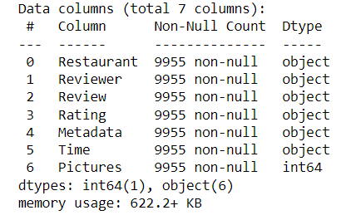
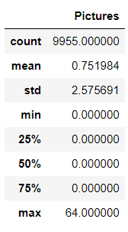
DATA CLEANING:
Then I check for any duplicate values in the dataset. And found there are 36 duplicate values in the dataset. So I remove that values using data processing.
Then I check for any null values in the dataset and drop them for further simple analysis and also get detail information about dataset using describe function.
B)Descriptive information of dataset
A)Column type information after further data processing

Slide 16
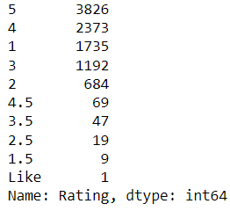
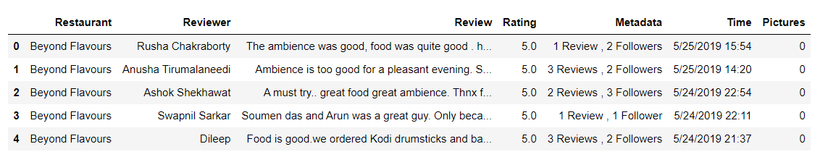
DATA CLEANING:
Then I check unique values count in rating column and replace some values with the value which has highest count and change the type of the column for further analysis of the dataset.
A)RATING COLUMN UNIQUE COUNT
B)LOOK OF DATASET AFTER CHANGING THE TYPE

Slide 17
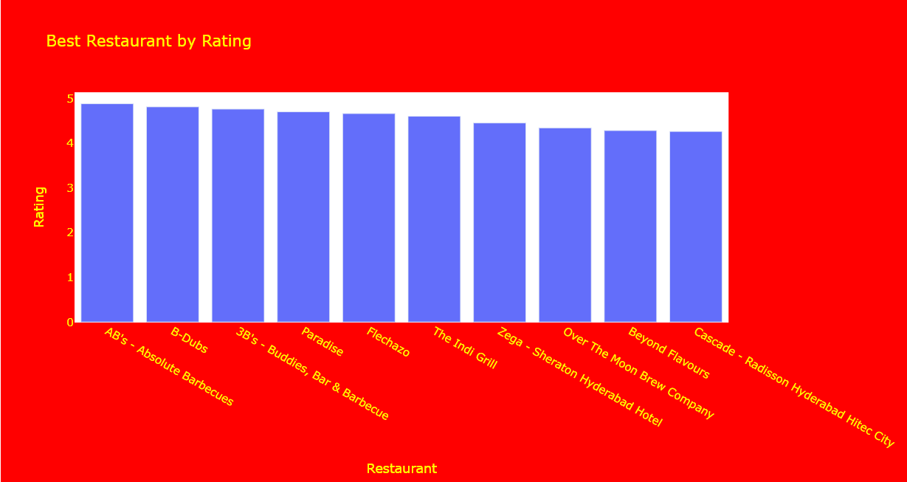
EDA ANALYSIS:
To properly understand how the customer behaves to every restaurants we must find out which restaurants is highest rating as the reviews of the customer.
So to find this I used a def function and matplotlib library to plot a graph which indicates restaurants with best rating count score in ascending order.
BEST RESTAURANT BY RATING SCORE

Slide 18
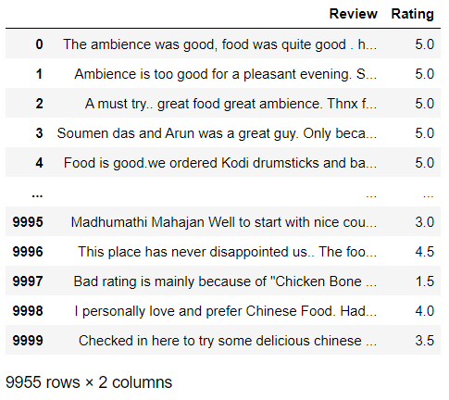
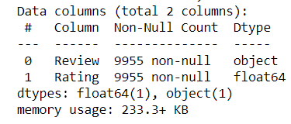
DATA PRE-PROCESSING:
For data pre-processing I only import 2 columns from dataset i.e; reviews and rating.
Then I get detail information of copied columns and confirm that it comes with past operations that I done in data cleaning.
B)COPIED COLUMN INFORMATION
A)COPIED COLUMNS

Slide 19
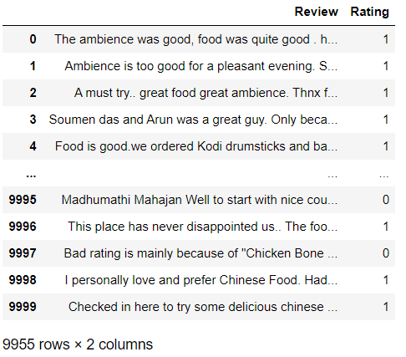
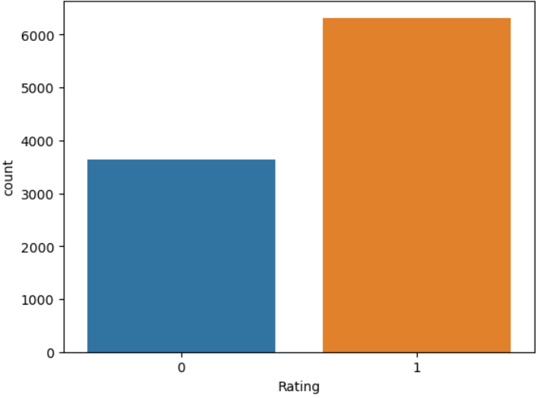
DATA PRE-PROCESSING:
Then using def function I differentiate positive and negative comments on basis of rating.
And using categorical values I differentiate reviews with less than 3 rating in ‘bad’ group and more than 3 in ‘good’ group.
Then using matplotlib I get information of total count of rating classes.
A)PROCESSED DATASET
B)PROCESSED COUNT OF RATING

Slide 20
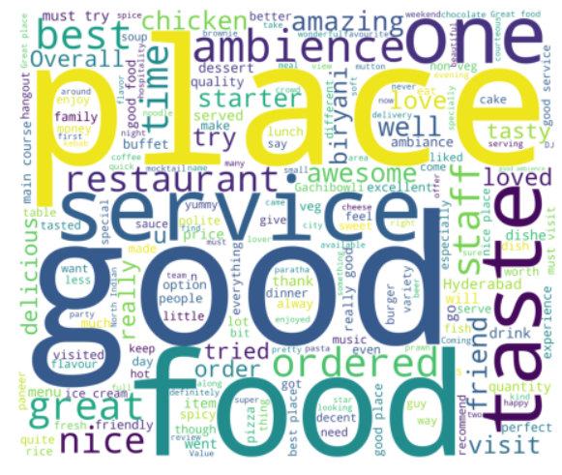
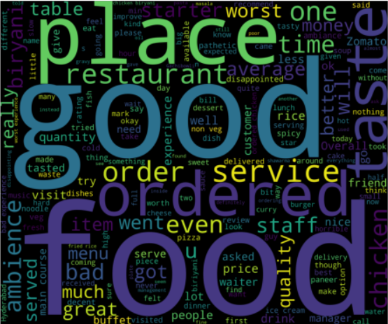
DATA PRE-PROCESSING:
Then using word cloud and def function I plot the structure of positive and negative comments.
From that I get information of highlighted areas of the restaurants by the customers.
A)POSITIVE SENTIMENT ANALYSIS
B)NEGATIVE SENTIMENT ANALYSIS

Slide 21
DATA PRE-PROCESSING:
Then using def functions , lemmatization , stemming I clean and manage the data for model building.
Firstly using stop-words library I clean all those words which are not that much important for analysis.
Then using stemming and lemmatization I properly change the words and bring them in that form where they act as a column for further analysis.
Then using count-vectorizer I convert all other remaining values in readable format for algorithms.
Then using train-test split I divided the data in industrial 80:20 criteria means 80% in train data and 20% in test data.
Then using lambda function I clean the data which is in train and test sample.

Slide 22
Model building:
As per said earlier we want to find the best classifier model for differentiating the negative and positive comments among mix comments.
For model building and to find best fitted model I used logistic , decision tree , k-nearest neighbour , random-forest , ada-boost , cat-boost and SCDC classifier algorithms.
Then using try and except function I find all the possible accuracy of the models which are taken for classification of comments.
Then I sort the values of accuracy of the algorithms and arrange them in descending order.
Then I plot those accuracy with the help of matplotlib library and seaborn library and here also I arrange them in descending order.

Slide 23
TOOLS AND PLATFORM USED:
As it is deep learning base project I used anaconda prompt as a Platform for implementation of the project.
For coding of the project I used jupyter python notebook and its different libraries for successful execution of every step.
The libraries are used is completely related to deep learning and machine learning area.
Libraries like pandas , numpy , matplotlib , def function , count-vectorizer , data cleaning tools , word cloud these common libraries for data handling and for classification and result purpose machine and deep learning algorithms are used like random-forest , decision tree , logistic regression , cat-boost , SGDC classifier , gaussian naive bayes , k-nearest neighbour and ada-boost ensemble technique.

Slide 24
ADVANTAGES:
As we all know processing of documents , emails , research results is difficult for computers to process. Using NLP we can do it easily and also we can implement correct accuracy for proper improvement.
Also using NLP we can find the right document which use same verbiage by reducing time and without human intervention.
NLP mainly used in sentiment analysis of comments which are given by customer for improvement for proper services by which any industry can change their strategy for development.
NLP also empowered employees by using chatbots which quickly find any information they needed for any tasks.
With using NLP there is reduce in cost and realizing benefits in different area of industries which can be helpful for automation.

Slide 25
DISADVANTAGES:
As NLP is very useful now-a-days there is still limitations to this toll is some areas. Its first limitations it contextual words and phrases means one word is used in different way. For NLP it is huge problem for understanding purpose.
Synonyms , irony and sarcasm are also the limitations of NLP as they express the idea of human but in different way.
Sometimes error in speech and misspelled in any word can cause problem in text analysis using NLP.
Informal phrases , expressions , idioms and cultural specific lingo are huge problems for NLP especially for that models which are broadly in use.
NLP is a domain-specific language due it get limited to get used for other analysis which use different languages.
In NLP there is still lack of research and development which restrict its uses in some areas.

Slide 26
CHALLENGES AND SOLUTION:
The biggest challenge is that as data is unstructured so cleaning of it is quiet difficult. Numerous process has to be done on data before any further analysis.
Solution on this is proper execution of different function and treatment of duplicate values which can hamper the analysis.
During EDA analysis I didn’t understand how to show the data in bar-graph as it contains reviews which we can’t represent through libraries.
But the solution I found is do the rating score of every restaurants and find out their development in customer’s perspective.
And last other challenge I face is working of logistic regression algorithms on data as quiet complicated its needed some extra values for implementation it gives some error during result execution.
The solution on this problem is proper structure of code and some extra adjustment in logistic regression model parameters.

Slide 27
APPLICATIONS , BENEFITS AND AMOUNT OF TIME:
NLP has different applications but its biggest applications is sentiment analysis which is used for industry development purpose.
Its other applications are its also use as a base for chatbots , voice assistants , language translator and grammar checking tool.
Like its applications in the benefits it can be used to detect fraudulent claims and behaviour.
Also it can find the pattern in customers communication and reduce their complaints.
NLP can analyse structure and unstructured data and evaluate competitors product offerings.
I required complete 16 days for completion of this project with proper execution of result and presentation making.

Slide 28
CONCLUSION [LAST PART]

Slide 29
OUTCOME:
From the result I got the best model which can classify the comments very well is Random-forest , SGDC classifier and cat-boost.
All other classifier also did well for classifying except logistic regression and gaussian naïve bayes.
Random forest is the bestest model with accuracy of 86%
Then after random-forest the model with highest accuracy of 84%
And lastly the 3rd best fitted model which can classify the comments properly is decision tree with accuracy of 83%.
As this data has some categorical background so the working of classification algorithms is smooth so I got better result than any other model.

Slide 30
Detailed accuracy of all the models:
MODEL | ACCURACY
RANDOM-FOREST | 86%
ADA-BOOST | 80%
DECISION TREE | 77%
SGDC CLASSIFIER | 83%
CAT-BOOST | 84%
K-NEAREST NEIGHBOUR | 71%
LOGISTIC REGRESSION | 62%
GAUSSIAN NAIVE BAYES | 58%

Slide 31
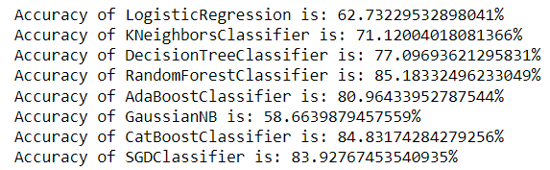
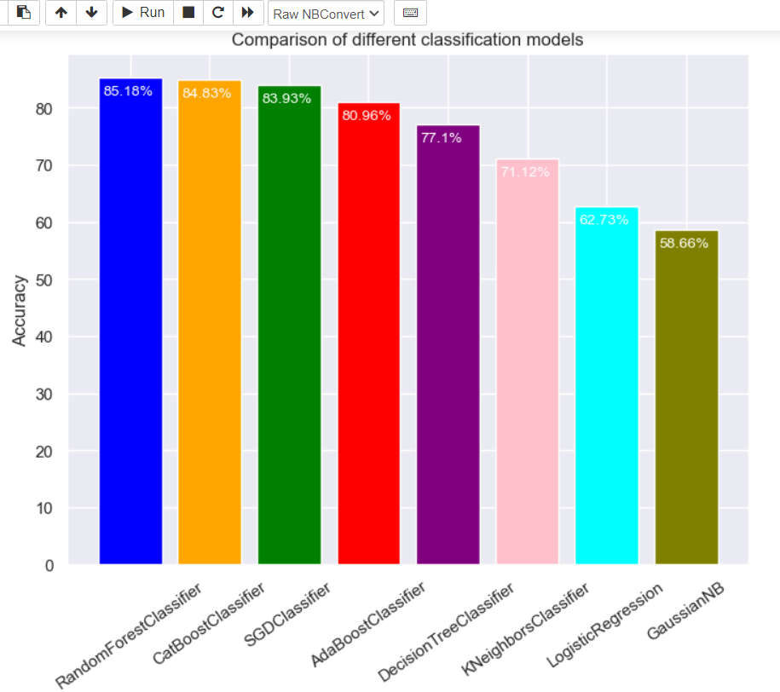
BAR GRAPH REPRESENTATION AND ACCURACY GOT THROUGH DEF FUNCTION:
A)ACCURACY IN DETAIL
B)BAR-CHART OF ACCURACY OF CLASSIFIERS

Slide 32
IMPROVEMENT:
NLP is a tool of deep learning it need to be improve in different areas. As first improvement is we can manage the stop-words which are main part of NLP with proper thought.
For NLP improvisation we need to be choose right data which can properly respond to the different operations.
For proper analysis through NLP we should adjust its parameters means example in case of finding proper classification model adjusting classifiers parameters is needed.
We should experiment with different models in NLP like hybrid models , rule-based models for capturing synthetic and semantic features of text.
Sometimes NLP needs external knowledge like domain-specific terminology , common sense reasoning. We should link this knowledge with NLP for future progress.

Slide 33
SUGGESTIONS:
IN NLP era we should focus on its limitations which prevent this tool for progress. Like we should enhance its compatibility with contextual phrases and words.
Also if we want complete any target through NLP we should bring the data in simple format which NLP can understand.
We have to work on areas where NLP can recognize and able to catch different pattern in human language for better result in sentiment analysis.
Our data should be proper manner like there is no any misspelled in text any other mistake in other column so no any pre-processing needed.
NLP should introduce with new option like it should introduce with every unique language by which it can be useful for any data in different industries.
As it is lack of research and development in NLP era we should work on it for its wide use purpose in future.

Slide 34
THANK YOU

